Slide 1
Coding sorting algorithms
Mack 2023
Notes:
Last updated: 12-9-2022

Slide 2

True or False
Starter activity
Choose whether each phrase for bubble sort and insertion sort is True or False.
 | True or False
Bubble sort compares items next to each other in the list and swaps them if they are in the wrong order.
Insertion sort compares an item from the unsorted sublist to the items in the sorted sublist and places it in the correct position.
Bubble sort is good at sorting large collections of unordered data.
Bubble sort can be really fast at sorting data that is nearly in order.
Insertion sort is usually slower to execute than bubble sort on large, unordered data sets.
True
True
False
True
False

Slide 3

Lesson 6: Coding sorting algorithms
Objectives
In this lesson, you will:
Interpret the code for bubble sort and insertion sort
Trace code for both sorting algorithms with input data
Identify factors that could influence the efficiency of a bubble sort implementation

Slide 4
Code for bubble sort
Activity 1
You need to be able to identify the code for a bubble sort algorithm, as well as analyse improvements that could be made and spot errors.
In the next slides you will go over a step-by-step breakdown of one version of a bubble sort algorithm written in Python.

Slide 5
Code for bubble sort
Activity 1
def bubble_sort( ):
Define a new procedure for bubble sort

Slide 6
Code for bubble sort
Activity 1
def bubble_sort( ):
Question What input data is needed for the algorithm’s parameters?

Slide 7
Code for bubble sort
Activity 1
def bubble_sort(items):
Question What input data is needed for the algorithm’s parameters?
Answer The algorithm receives a list of items as a parameter.

Slide 8
Code for bubble sort
Activity 1
def bubble_sort(items):
for current in range( ):
A single pass:
Iterate over the items list
current is the index of the current item.
The values it ranges over will be determined after we specify the statements executed in the pass.

Slide 9
Code for bubble sort
Activity 1
def bubble_sort(items):
for current in range( ):
if items[current] > items[current+1]:
A single pass:
Iterate over the items list
Compare the current item to the one next to it.
Question What happens if the items are in the wrong order?

Slide 10
Code for bubble sort
Activity 1
def bubble_sort(items):
for current in range( ):
if items[current] > items[current+1]:
temp = items[current]
items[current] = items[current+1]
items[current+1] = temp
A single pass:
Iterate over the items list
Compare the current element to the one next to it.
Answer Swap the two elements if they are in the wrong order.

Slide 11
Code for bubble sort
Activity 1
def bubble_sort(items):
for current in range( ):
if items[current] > items[current+1]:
temp = items[current]
items[current] = items[current+1]
items[current+1] = temp
Question Which index values should current range over?
Tip How many items need to be compared in a single pass?

Slide 12
Code for bubble sort
Activity 1
def bubble_sort(items):
num_items = len(items)
for current in range(num_items - 1):
if items[current] > items[current+1]:
temp = items[current]
items[current] = items[current+1]
items[current+1] = temp
Initialisation
num_items stores the number of elements in the items list.
Question Which index values should current range over?
Answer All the item indices except the last one.
In the last iteration, the last two items will be compared.

Slide 13
Code for bubble sort
Activity 1
def bubble_sort(items):
num_items = len(items)
while :
for current in range(num_items - 1):
if items[current] > items[current+1]:
temp = items[current]
items[current] = items[current+1]
items[current+1] = temp
The statements for a single pass are placed inside a loop, so that the process is repeated.

Slide 14
Code for bubble sort
Activity 1
def bubble_sort(items):
num_items = len(items)
while :
for current in range(num_items - 1):
if items[current] > items[current+1]:
temp = items[current]
items[current] = items[current+1]
items[current+1] = temp
Question What is the condition for the while loop? For how long should the passes be repeated?

Slide 15
Code for bubble sort
Activity 1
def bubble_sort(items):
num_items = len(items)
passes = 1
while passes < num_items:
for current in range(num_items - 1):
if items[current] > items[current+1]:
temp = items[current]
items[current] = items[current+1]
items[current+1] = temp
passes = passes + 1
Question What is the condition for the while loop? For how long should the passes be repeated?
Answer Each pass sets at least one more item into its final position.
Use the passes variable to count the number of passes and repeat until all elements have reached their final position.

Slide 16

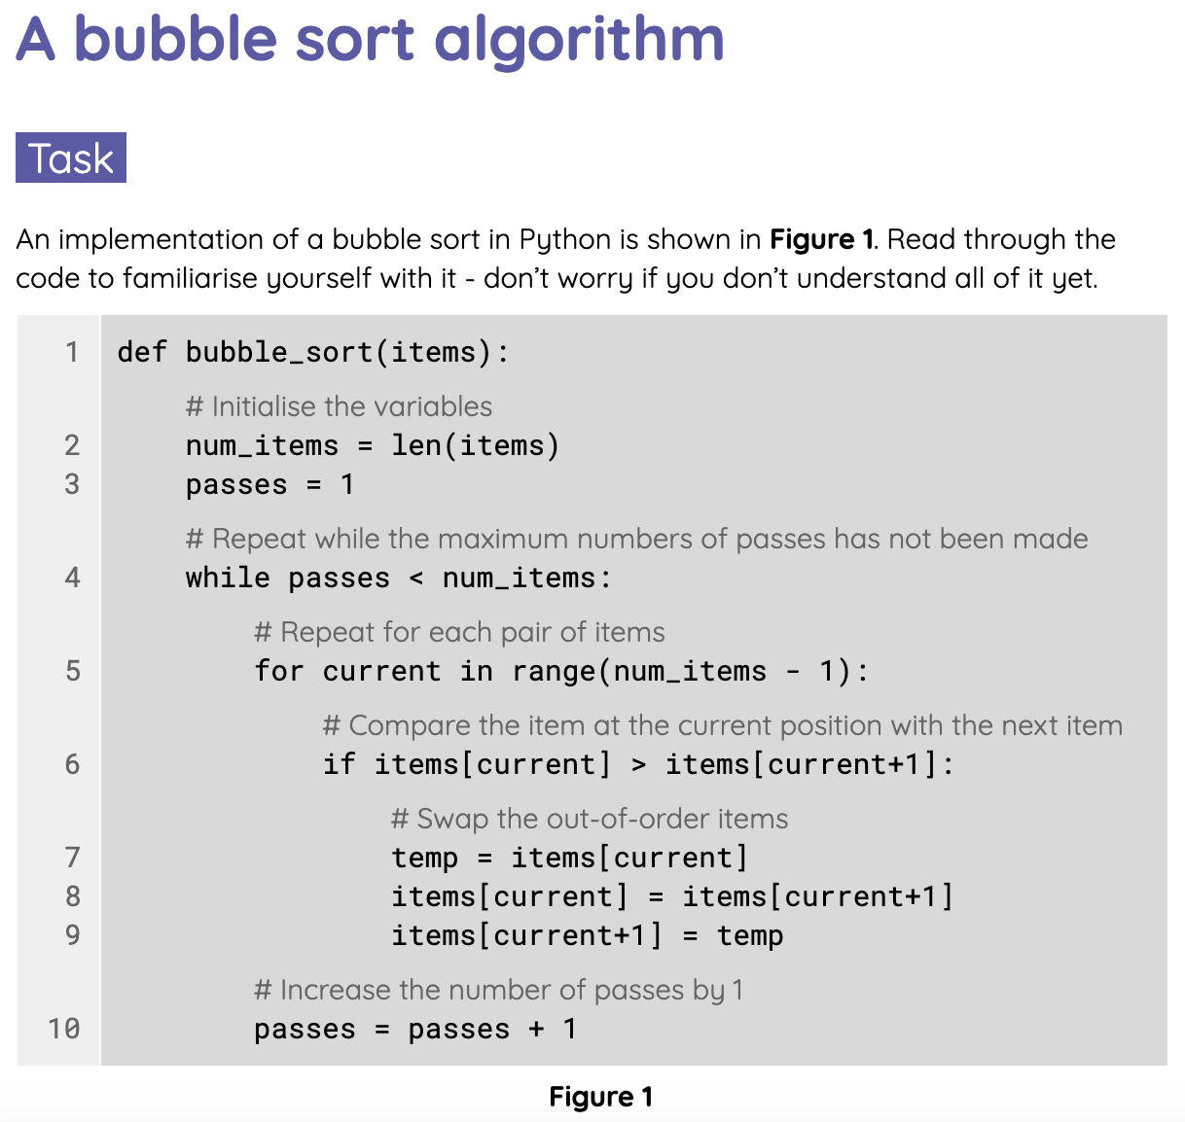
Code for bubble sort
Activity 1
The next worksheet contains one version of the bubble sort algorithm written in Python.
Complete the tasks on the Activity 1 worksheet.

Slide 17

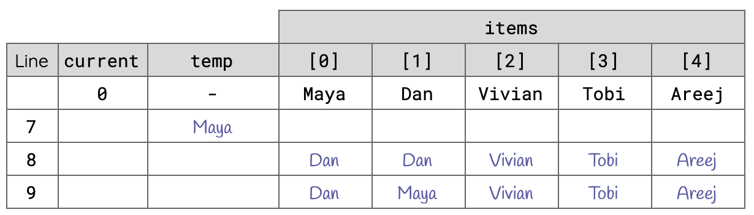
Code for bubble sort - trace table solution
Activity 1

Slide 18
Code for bubble sort: making improvements
Activity 2
The previous version of the bubble sort algorithm in Python works but it can be made more efficient.
You are going to look at two improvements to the code: reducing the number of comparisons after each pass and stopping once no swaps are made during a single pass.

Slide 19
Code for bubble sort: making improvements (1)
Activity 2
def bubble_sort(items):
num_items = len(items)
passes = 1
while passes < num_items:
for current in range(num_items - passes):
if items[current] > items[current+1]:
temp = items[current]
items[current] = items[current+1]
items[current+1] = temp
passes = passes + 1
Tip Each pass sets at least one more item into its final position.
Improvement 1 No need for each pass to iterate over all the items. As the number of passes increases, the number of ordered elements increases and the range of indices for the current index decreases.

Slide 20
Code for bubble sort: making improvements (2)
Activity 2
def bubble_sort(items):
num_items = len(items)
passes = 1
while passes < num_items:
for current in range(num_items - passes):
if items[current] > items[current+1]:
temp = items[current]
items[current] = items[current+1]
items[current+1] = temp
passes = passes + 1
Tip If no elements are swapped during a pass, then the list is sorted.
Improvement 2 Keep track of any swaps that were made and then stop the algorithm once no elements are swapped in a single pass.

Slide 21
Code for bubble sort: making improvements (2)
Activity 2
def bubble_sort(items):
num_items = len(items)
passes = 1
while passes < num_items:
swapped = False
for current in range(num_items - passes):
if items[current] > items[current+1]:
temp = items[current]
items[current] = items[current+1]
items[current+1] = temp
swapped = True
passes = passes + 1
swapped is a flag which will indicate if any swaps were made during a single pass.
It is lowered at the start of each pass and raised if a swap is made.

Slide 22
Code for bubble sort: making improvements (2)
Activity 2
def bubble_sort(items):
num_items = len(items)
passes = 1
while :
swapped = False
for current in range(num_items - passes):
if items[current] > items[current+1]:
temp = items[current]
items[current] = items[current+1]
items[current+1] = temp
swapped = True
passes = passes + 1
swapped is a flag which will indicate if any swaps were made during a single pass.
Question How can the swapped flag be used so that more passes are performed only if the flag has been raised, i.e. the list is not sorted yet?

Slide 23
Code for bubble sort: making improvements (2)
Activity 2
def bubble_sort(items):
num_items = len(items)
passes = 1
swapped = True
while swapped == True:
swapped = False
for current in range(num_items - passes):
if items[current] > items[current+1]:
temp = items[current]
items[current] = items[current+1]
items[current+1] = temp
swapped = True
passes = passes + 1
swapped is a flag which will indicate if any swaps were made during a single pass.
Answer Continue passing through the list while swapped is True i.e. a swap was made in the previous pass.

Slide 24
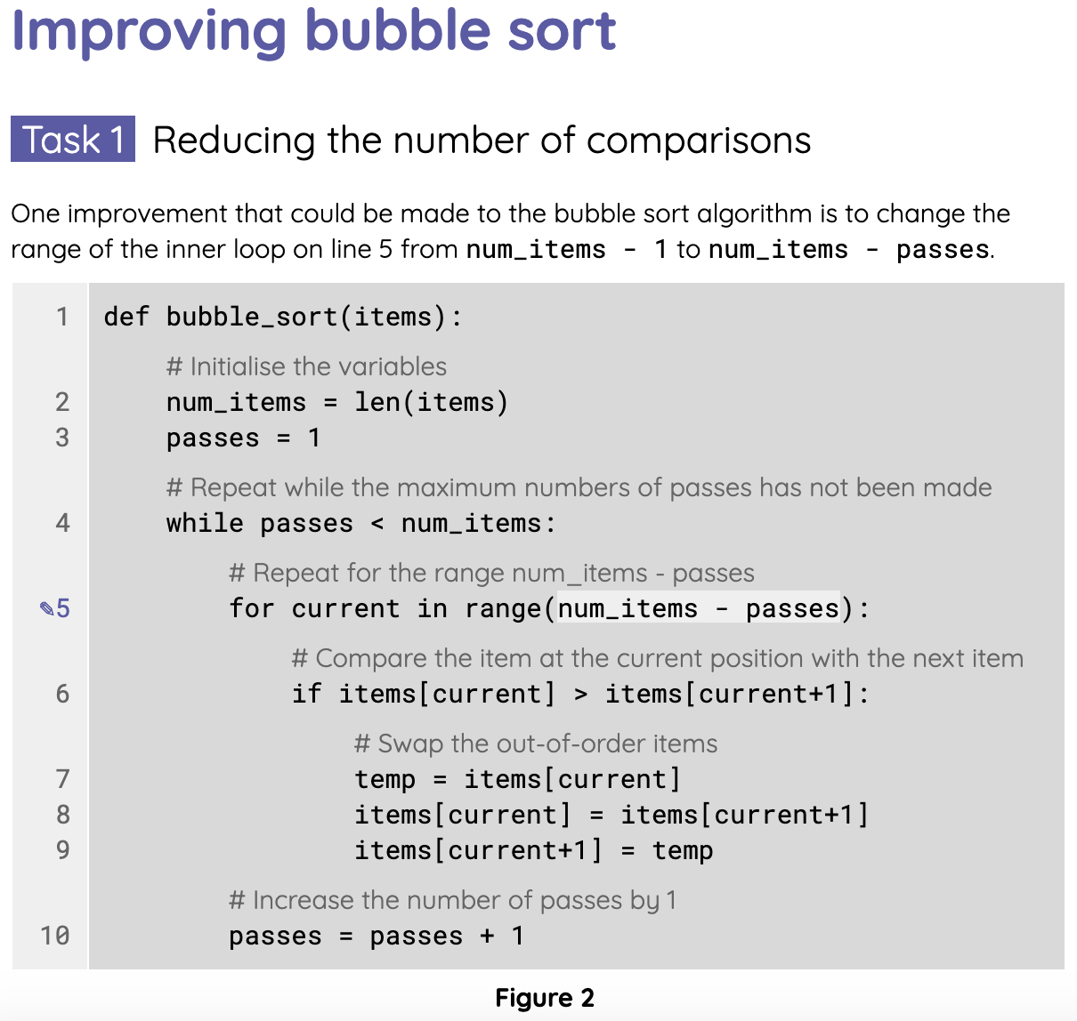
Code for bubble sort: making improvements
Activity 1
The next worksheet is based on two improvements that can be made to the bubble sort algorithm.
Complete the tasks on the Activity 2 worksheet.

Slide 25
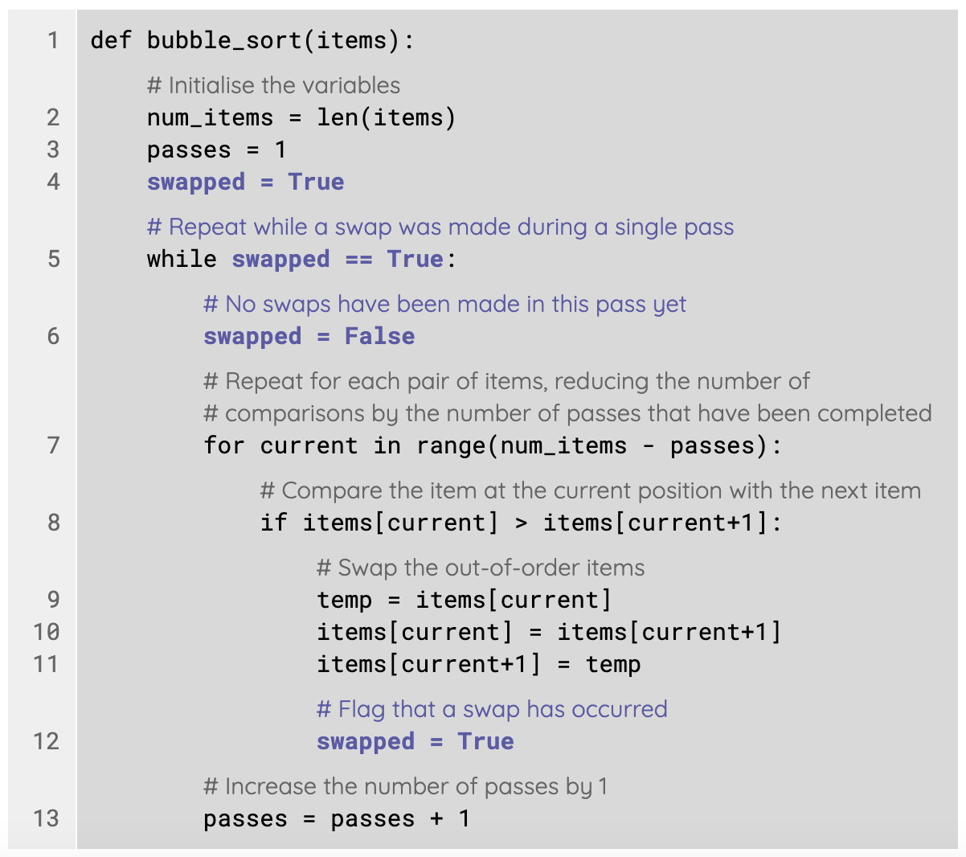
Code for bubble sort: making improvements
Activity 1

Slide 26
Code for insertion sort
Activity 3
As well as bubble sort, you also need to be able to identify the code for insertion sort.
In the next slides you will go over a step-by-step breakdown of an insertion sort algorithm written in Python.

Slide 27
Code for insertion sort
Activity 3
def insertion_sort( ):
Define a new procedure for insertion sort

Slide 28
Code for insertion sort
Activity 3
def insertion_sort( ):
Question What input data is needed for the algorithm’s parameters?

Slide 29
Code for insertion sort
Activity 3
def insertion_sort(items):
Question What input data is needed for the algorithm’s parameters?
Answer The algorithm receives a list of items as a parameter.

Slide 30
Code for insertion sort
Activity 3
def insertion_sort(items):
value = items[first_unordered]
first_unordered is the index of the first item in the unordered section of the list.
The value of this item is stored.
This is the value that will be inserted at the appropriate position within the ordered section of the list.

Slide 31
Code for insertion sort
Activity 3
def insertion_sort(items):
value = items[first_unordered]
current = first_unordered - 1
current is the index of the current item.
It starts at the last item in the ordered section of the list, right before the first unordered item.

Slide 32
Code for insertion sort
Activity 3
def insertion_sort(items):
value = items[first_unordered]
current = first_unordered - 1
items[current+1] = items[current]
Copy the value of the current item into the one next to it.
Imagine this like “shifting” an item to the right, to make room for the new value to be inserted.

Slide 33
Code for insertion sort
Activity 3
def insertion_sort(items):
value = items[first_unordered]
current = first_unordered - 1
while :
items[current+1] = items[current]
current = current - 1
Repeat this “shifting” to the right process, with the current index iterating over the elements of the ordered section of the list.

Slide 34
Code for insertion sort
Activity 3
def insertion_sort(items):
value = items[first_unordered]
current = first_unordered - 1
while :
items[current+1] = items[current]
current = current - 1
Repeat this “shifting” to the right process, with the current index iterating over the elements of the ordered section of the list.
Question When will the “shifting” process stop, so that the new value can be inserted?

Slide 35
Code for insertion sort
Activity 3
def insertion_sort(items):
value = items[first_unordered]
current = first_unordered - 1
while items[current] > value:
items[current+1] = items[current]
current = current - 1
Repeat this “shifting” to the right process, with the current index iterating over the elements of the ordered section of the list.
Question When will the “shifting” process stop, so that the new value can be inserted?
Answer As long as the current item is greater than the new value, it needs to be “shifted”, to make room for the new value.

Slide 36
Code for insertion sort
Activity 3
def insertion_sort(items):
value = items[first_unordered]
current = first_unordered - 1
while current >= 0 and items[current] > value:
items[current+1] = items[current]
current = current - 1
Repeat this “shifting” to the right process, with the current index iterating over the elements of the ordered section of the list.
Question When will the “shifting” process stop, so that the new value can be inserted?
Answer The “shifting” also stops when the current index goes beyond the first list item, i.e. there are no more elements to shift.

Slide 37
Code for insertion sort
Activity 3
def insertion_sort(items):
value = items[first_unordered]
current = first_unordered - 1
while current >= 0 and items[current] > value:
items[current+1] = items[current]
current = current - 1
items[current+1] = value
Insert the new value after the point where the current index stopped.
The ordered section of the list is now extended by one item.

Slide 38
Code for insertion sort
Activity 3
def insertion_sort(items):
num_items = len(items)
for first_unordered in range(1, num_items):
value = items[first_unordered]
current = first_unordered - 1
while current >= 0 and items[current] > value:
items[current+1] = items[current]
current = current - 1
items[current+1] = value
Perform this process iteratively, incrementing the first_unordered index in each iteration, i.e. extending the ordered section of the list.

Slide 39
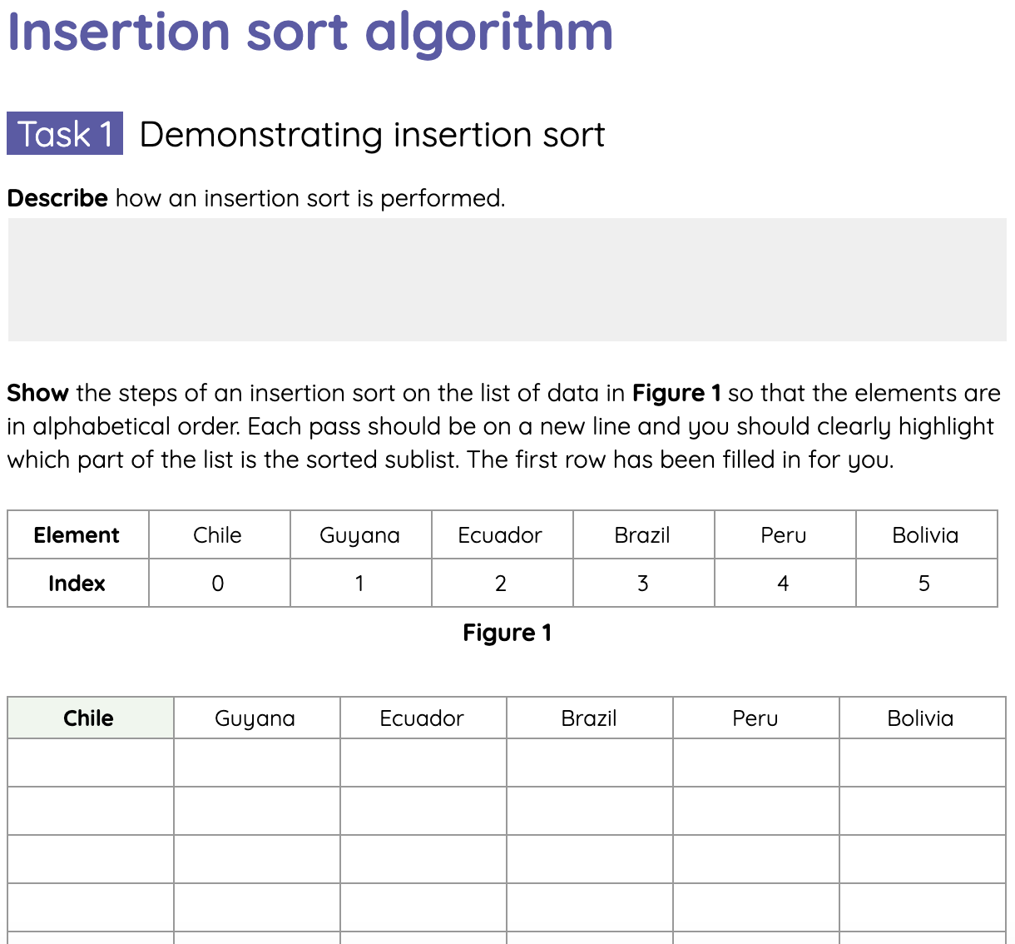
Code for insertion sort
Activity 3
The final worksheet is based on the insertion sort algorithm in Python.
Complete the tasks on the Activity 3 worksheet.

Slide 40
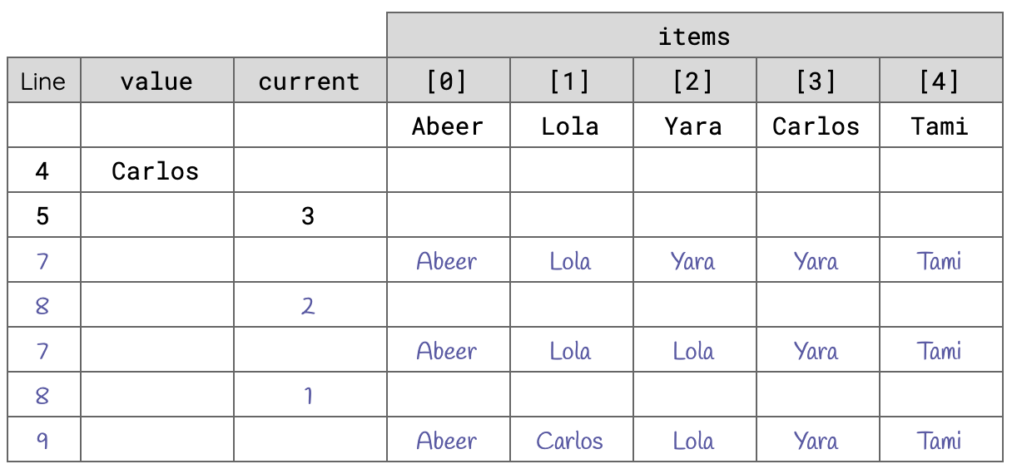
Code for insertion sort - trace table solution
Activity 3

Slide 41

Summary of bubble sort and insertion sort
Wrap Up
Bubble sort compares elements next to each other in the list and swaps them if they are in the wrong order.
A more efficient version of bubble sort uses a variable to flag when a swap was made during a single pass.
The insertion sort algorithm copies the value to be inserted in a variable at the start of each pass.
During a pass of an insertion sort, elements in the sorted part of the list are copied into the next position to make space for the value to be inserted.

Slide 42
Next lesson
Summary
In this lesson, you…
Interpreted the code for bubble sort and insertion sort.
Traced code for both sorting algorithms with input data.
Identified factors that could influence the efficiency of a bubble sort implementation.
Next lesson, you will…
Investigate the final sorting algorithm, merge sort.

